Slide 1
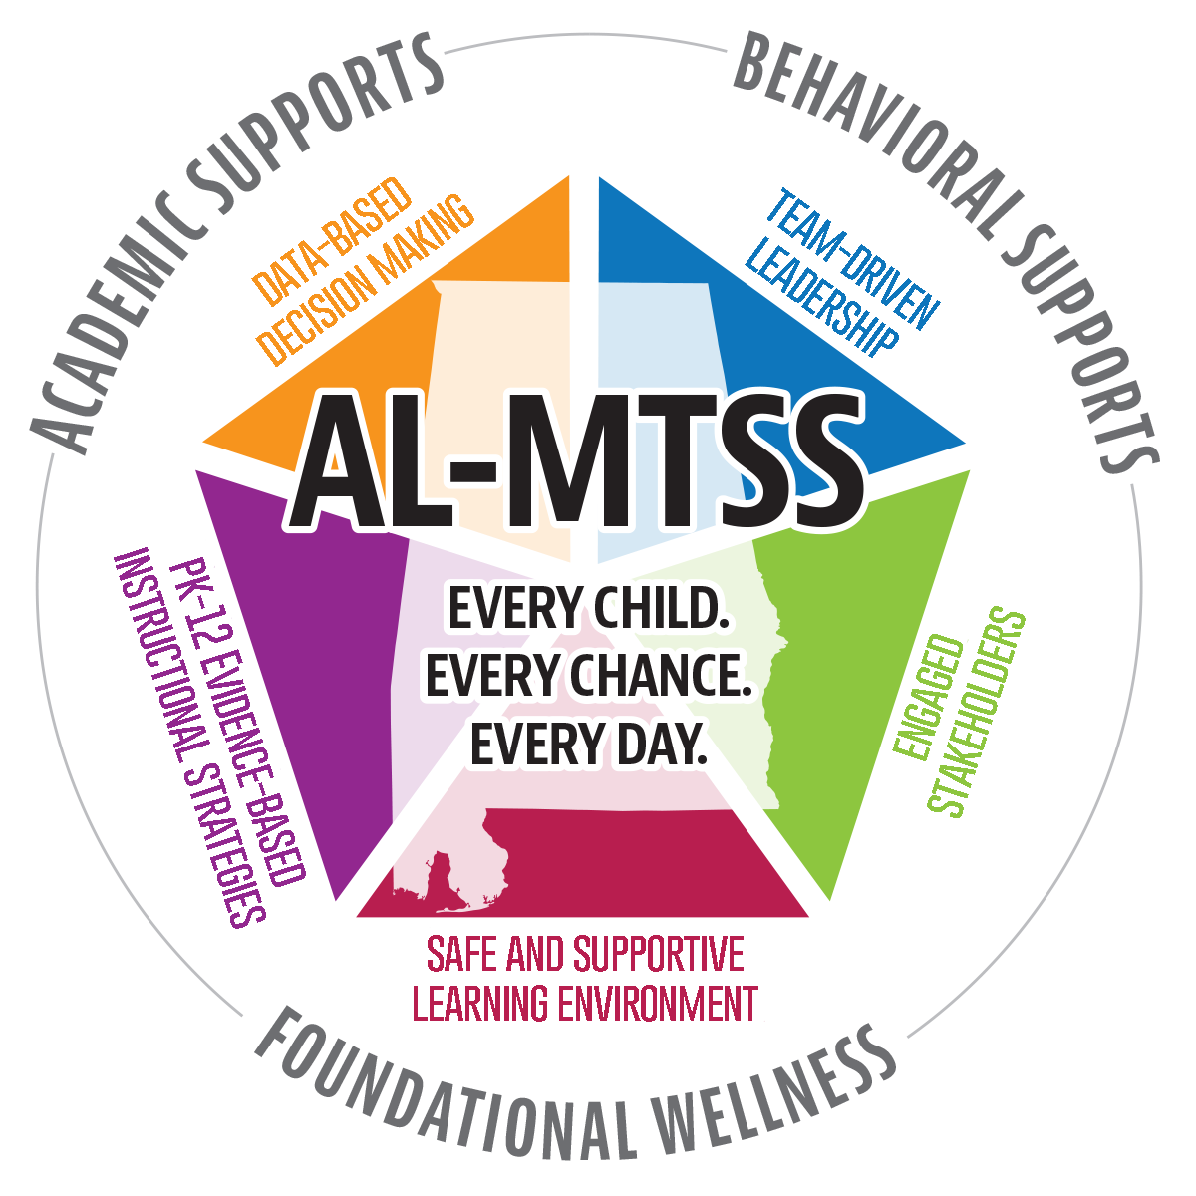
Alabama Multi-Tier System of Supports
Not another thing to add to the plate…AL-MTSS IS the plate!
Safety
School Climate
Attendance
Academics
Character Education
Behavior
Mental Health
Academics
Lifeskills
Basic Needs
Physical Health
Behavior
Family, School, & Community Partnerships
Foundational Wellness
Notes:
MTSS Elevator Pitch. We are already doing these things. It’s good school!

Slide 2
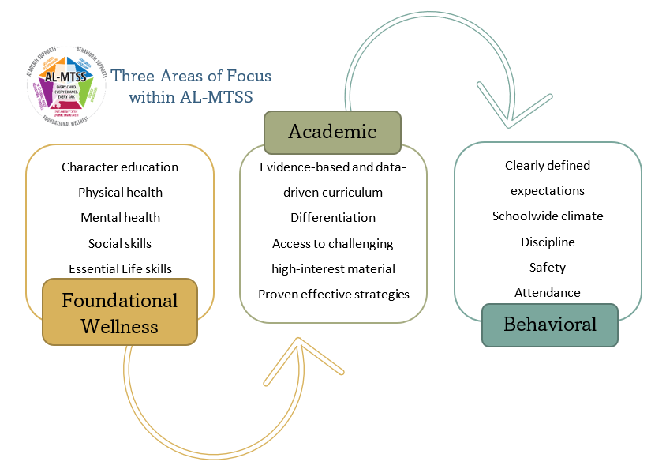
Notes:
3 Focus areas: Foundational Wellness & Behavior needs addressed with the PBS model, Academic needs addressed with the RTI model.
These things are happening already in most cases, but they are so often discussed and addressed in isolation. Through PST, these can and should be addressed collectively because of their interrelated nature. Each can have profound effects on others.

